Slide 1

A PRESENTATION ON
UPCOMING STORAGE TECHNOLOGIES
GHULE PRABHAT PANDURANG 10303320181124510027

Slide 2
INTRODUCTION
1. DNA Digital Storage
2 . HAMR(Heat Assisted Magnetic Recording
3 . Magnetoresistive RAM

Slide 3

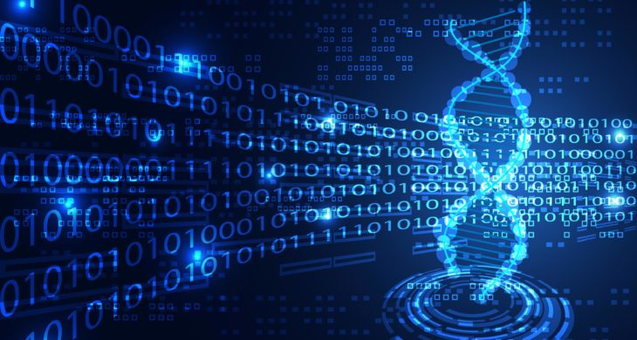
DNA Digital Data Storage
The process of encoding and decoding binary data to and from synthesized strands of DNA.
High storage density
High cost
Slow read and write

Slide 4

Cell free :
Currently the most wide spread DNA sequencing technology in use is one developed by Illumina .
A recently developed alternative is the nanopore technology in which DNA molecules are passed through a nano scale pore under the control of a ratcheting enzyme. The passage of the DNA molecules causes small change in electrical current that can be measured. The main advantage of the nanopore technology is that it can be read in real time.However the read accuracy of this technology is currently insufficient for data storage.

Slide 5
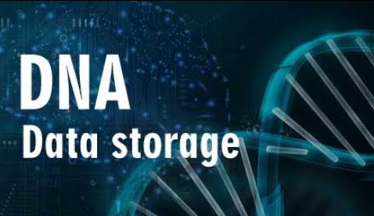
In 2012, George Church and colleagues at Harvard University published an article in which DNA was encoded with digital information that included an HTML draft of a 53,400 word book written by the lead researcher, eleven JPG images and one JavaScript program.
This result showed that besides its other functions, DNA can also be another type of storage medium such as hard drives and magnetic tapes.

Slide 6
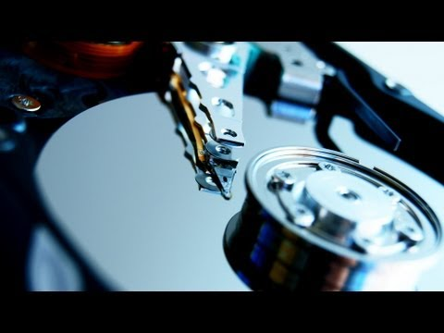
Heat Assisted Magnetic Recording :
Greatly increasing the amount of data that can be stored on a magnetic device such as a hard disk drive.
The regions being written must be heated in a tiny area.
Can be used identically to existing hard drives.

Slide 7
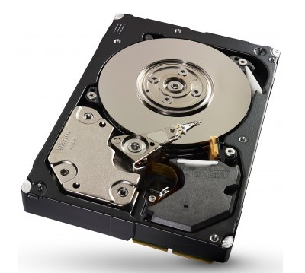
Seagate Technology announced that HAMR would be launched commercially in 2019
16 TB drives, with 20 TB expected in 2020, 24 TB drives in advanced development, and 40 TB drives by around 2023

Slide 8
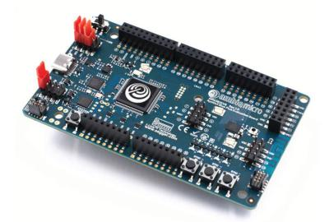
Magnetoresistive RAM :
Magnetoresistive random-access memory (MRAM) is a type of non-volatile random-access memory.
Like conventional RAM ,data is not stored as electric charge , it stores data in magnetic domains.

Slide 9
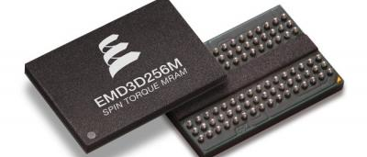
Applications of MRAM :
MRAM include devices such as aerospace and military systems, digital cameras, notebooks, smart cards, Mobile telephones
MRAM enabled the vendor to achieves new levels of performance, storage capacity and reliability.

Slide 10
Conclusion:
Thus, using DNA for data storage ,it is possible to store huge amount of data in very less size.
As DNA can retain data for millions of years , it is possible to store data for a long time.
By using this technique , data is compressed and the security to the data is provided.
Parallel reading of files is also possible enabling users to read multiple files at the same time.
This technique can be used in future to store the whole data of the various companies in very small space.

